Slide 1
Sentiment Monitor Prototype
Justin Ward
Hasan Khan
Nathan Sheperd
Dominic Thomas
LMI | September 2019

Slide 2
Question
How are publication houses talking about certain entities? How have narratives on these entities shifted over time?

Slide 3


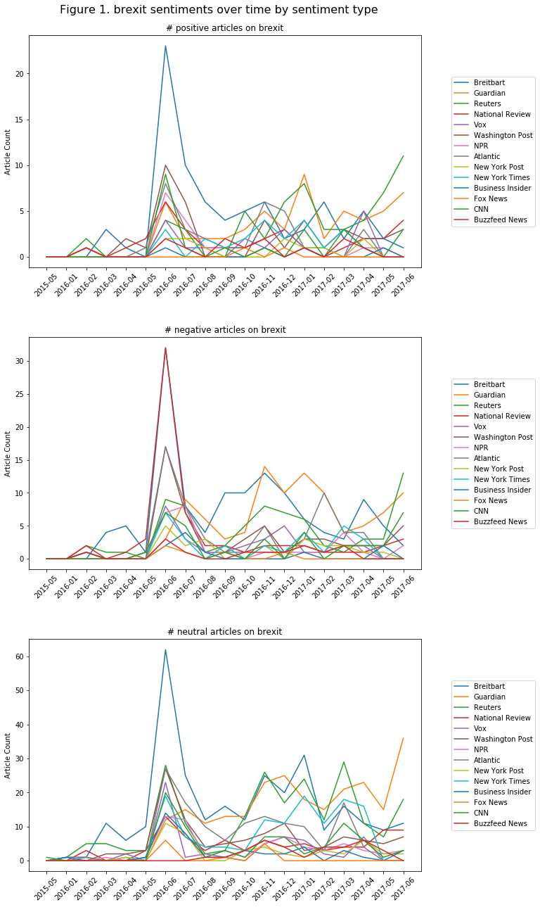
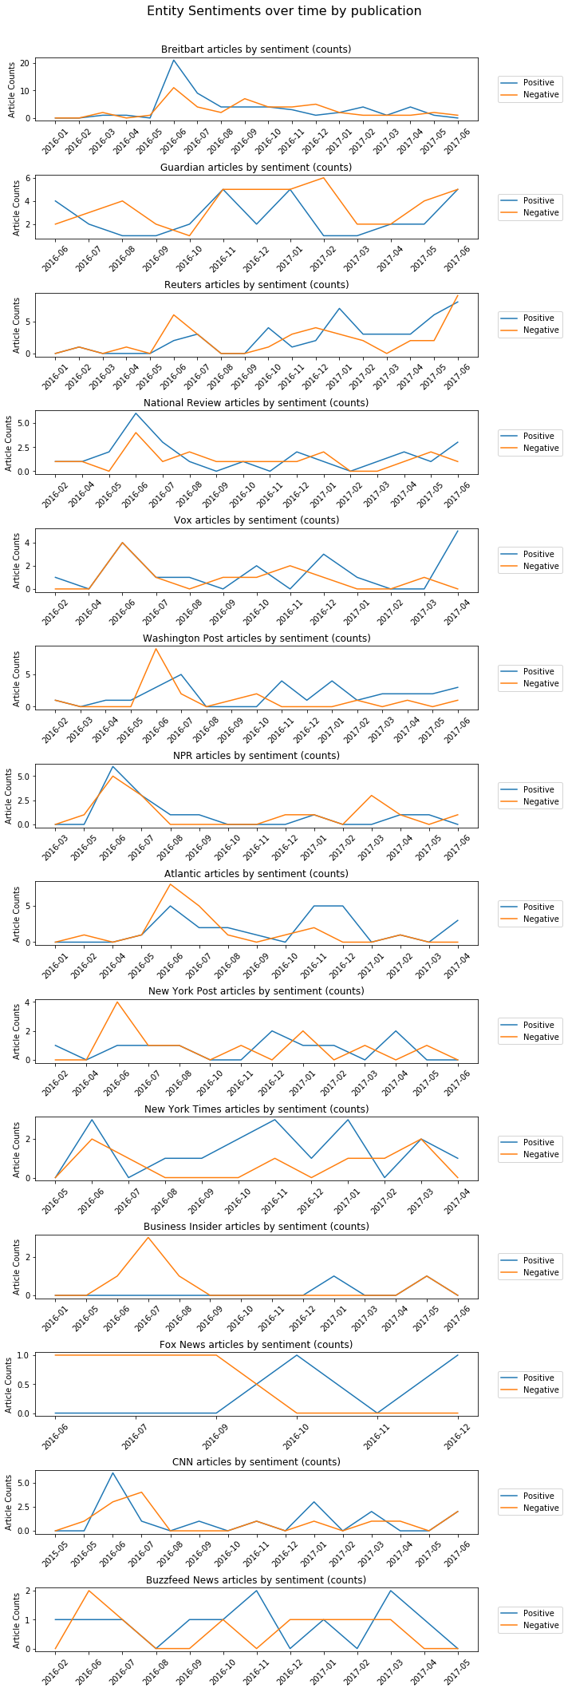
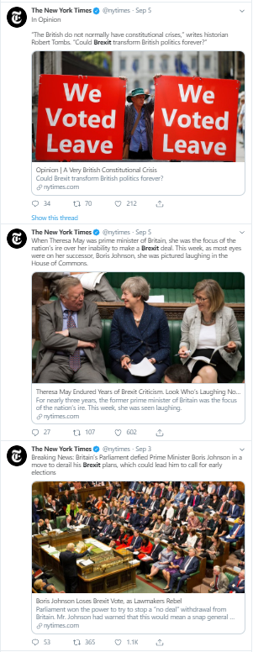
Vision
Brexit

Slide 4
Theoretical use cases
Measuring possible foreign media influence
Tracking changes in newspaper voice
Monitoring propaganda

Slide 5
Idea
For a given entity, track the sentiment over time for that entity grouped by publication source

Slide 6
Project Flow
Find suitable open source dataset (All the News)
Create elasticsearch index on news dataset
Create organized dataframe with relevant article information
Calculate sentiment scores for each article using Vader / Textblob
Aggregate over monthly time periods, per publication
Visualize sentiment scores over time

Slide 7
Results

Slide 8
Figure 1. Brexit sentiments over time by publication

Slide 9
Figure 2. Brexit sentiments over time by sentiment type

Slide 10
Improvements
Build a front end interface
Connect to larger/live datasets
Utilize dependency parsing and pre-trained models for sharper sentiment analysis
Expand dimensions of sentiment from good/bad binary
Integrate with publication social media feeds

